Slide 1
Communicating with Data –Deceptive Visualizations & Design Rules of Thumb
Dr. Ab Mosca (they/them)
Slides based off slides courtesy of Jordan Crouser (https://jcrouser.github.io/)

Slide 2
Plan for Today
Avoiding bias and trickery in visualization design
Design Rules of Thumb

Slide 3
Flashback
What are some perceptual tricks we learned about previously?
Notes:
The last thing I want us to think about is avoiding bias and trickery in the visualization we make, and when we’re reading visualizations designed by others.
The first thing to think about when you look at any visualization is your data source and potential biases. Who collected the data being visualized? Was it collected in a way that creates biases? Things to look for include over collection of one group and lack of representation of other groups, poor (or undisclosed) data cleaning practices, etc..
For example, if we look at this example dataset, can anyone point out any biases?

Slide 4
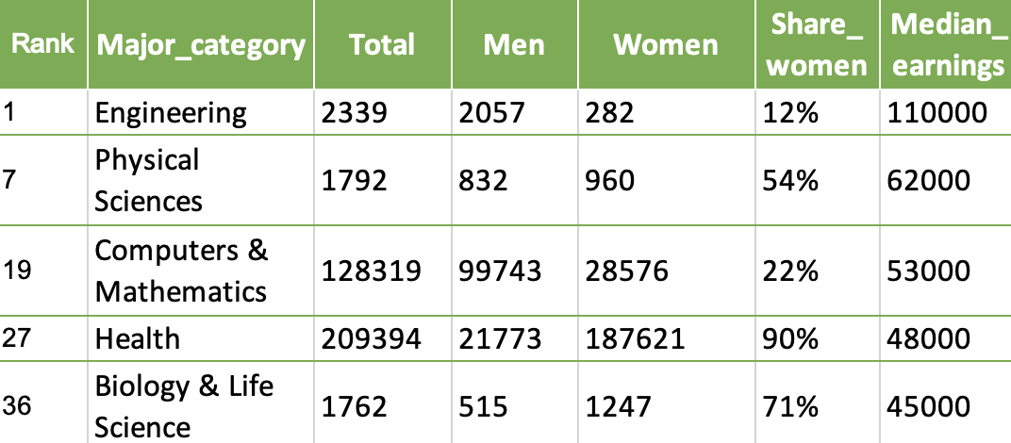
How do we avoid bias & trickery?
Inspect the data
→ Source?
→ Biases?
Data: https://github.com/fivethirtyeight/data/blob/master/college-majors/women-stem.csv
Notes:
The last thing I want us to think about is avoiding bias and trickery in the visualization we make, and when we’re reading visualizations designed by others.
The first thing to think about when you look at any visualization is your data source and potential biases. Who collected the data being visualized? Was it collected in a way that creates biases? Things to look for include over collection of one group and lack of representation of other groups, poor (or undisclosed) data cleaning practices, etc..
For example, if we look at this example dataset, can anyone point out any biases?

Slide 5
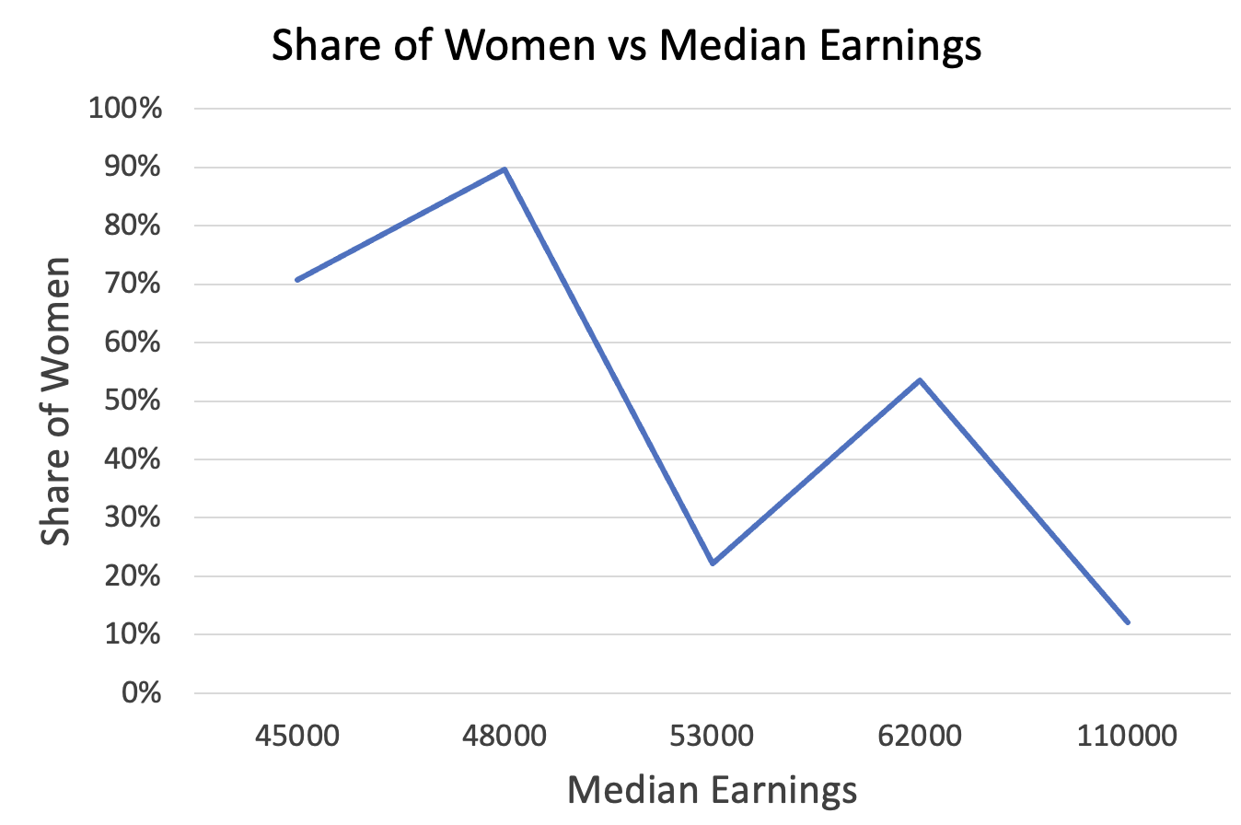
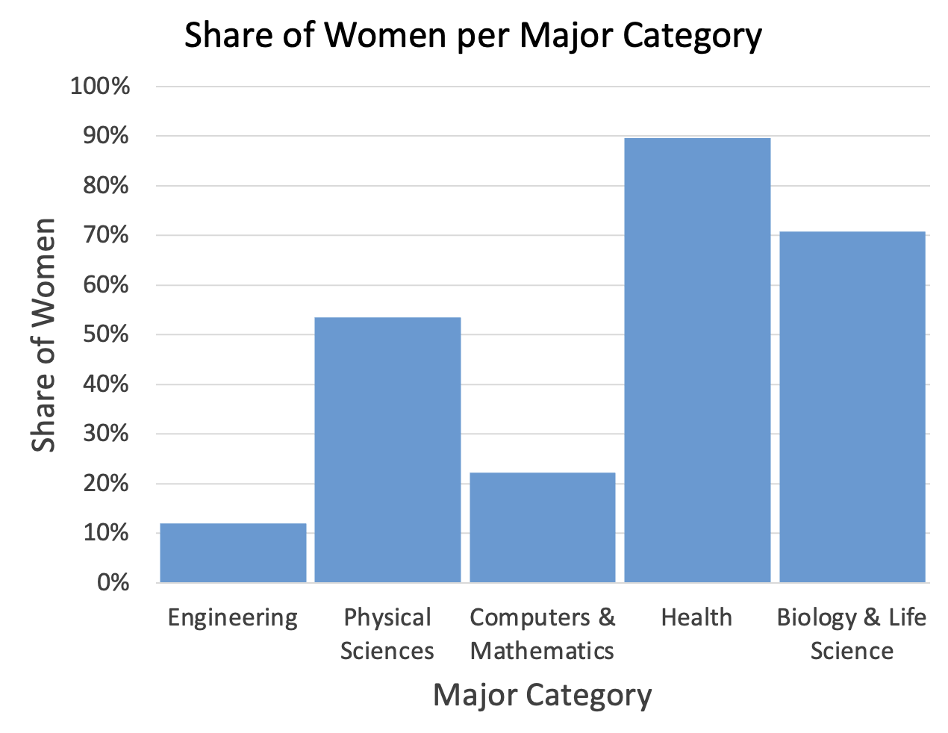
How do we avoid bias & trickery?
Design Contentiously & Read Critically
→ What’s shown vs not?
Data: https://github.com/fivethirtyeight/data/blob/master/college-majors/women-stem.csv
Notes:
Even if we don’t have access to raw data, careful critical reading of visualizations can show biases present in the under laying data.
For example, you could look at either of these charts and postulate that the underlaying data might only be divided into women and not women and therefore misses groups of people.

Slide 6
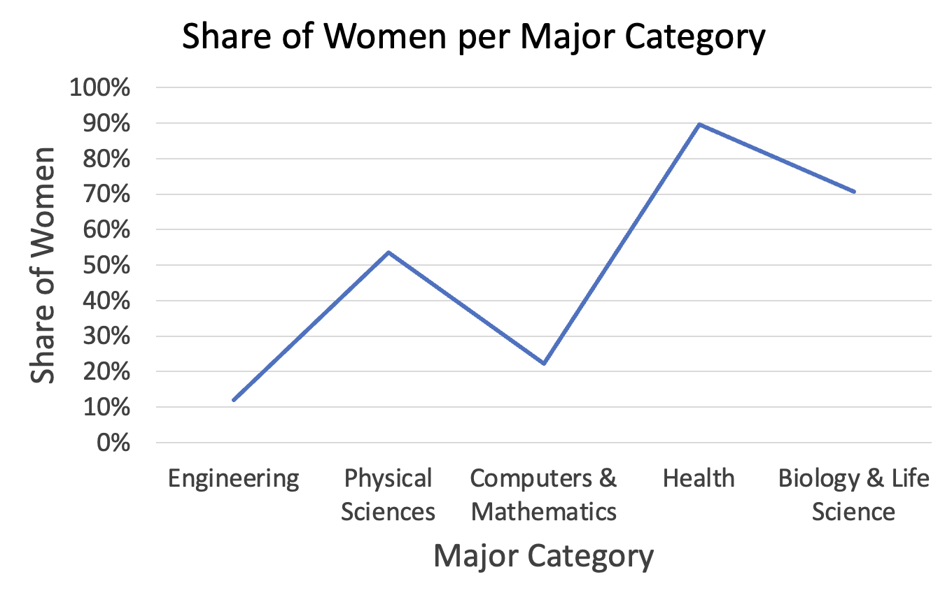
How do we avoid bias & trickery?
Design Contentiously & Read Critically
→ Goal
→ Data types
Data: https://github.com/fivethirtyeight/data/blob/master/college-majors/women-stem.csv
Notes:
Another point to think about is designing contentiously and reading critically.
We know goals and data types inform what kind of visualization is appropriate to use. And we can use this information to inform our reading of visualizations.
For example, can anyone point out the issue with this chart based on what we just discussed with respect to line charts?

Slide 7
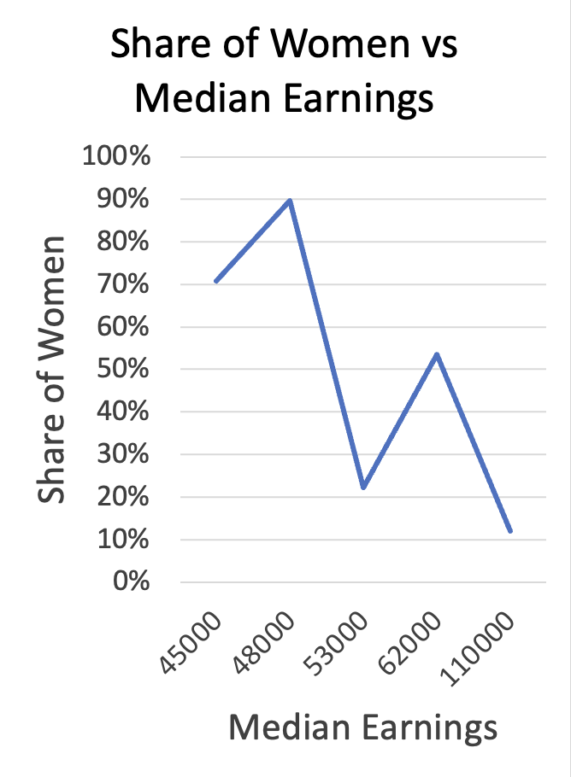
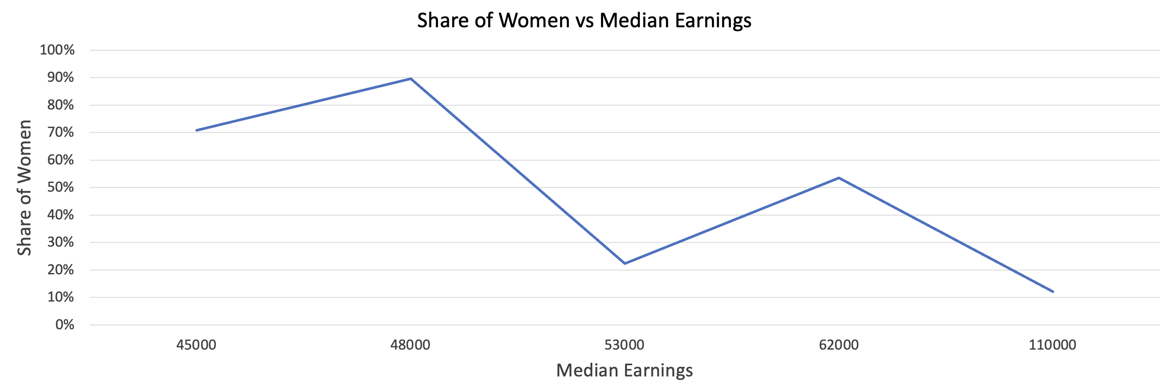
How do we avoid bias & trickery?
Design Contentiously & Read Critically
→ Aspect ratio
Data: https://github.com/fivethirtyeight/data/blob/master/college-majors/women-stem.csv
Notes:
Another way that visualizations can be deceptive is through the aspect ratio chosen for them.
For example here I’m showing one chart with 3 different aspect ratios. You can see when I stretch the chart width-wise, my changes look much less dramatic.
Likewise, when I squish it width-wise my changes look far more dramatic.

Slide 8
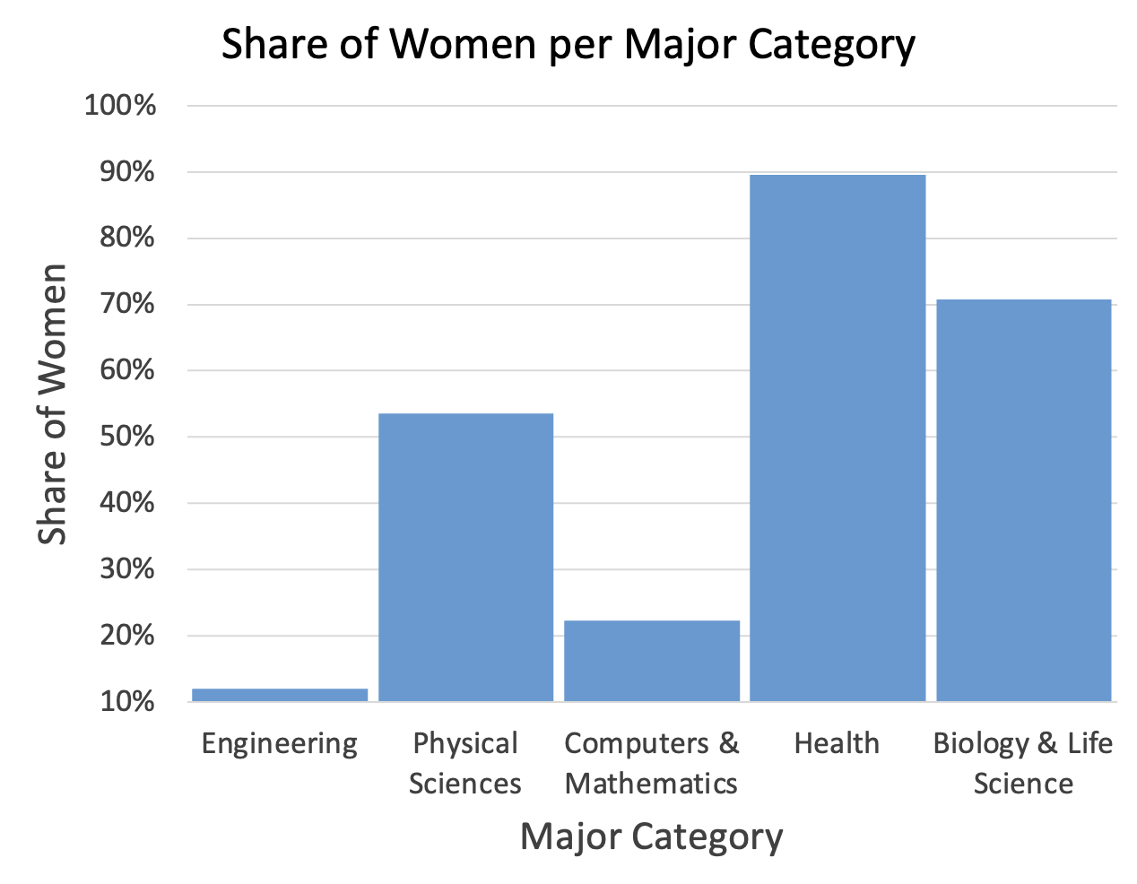
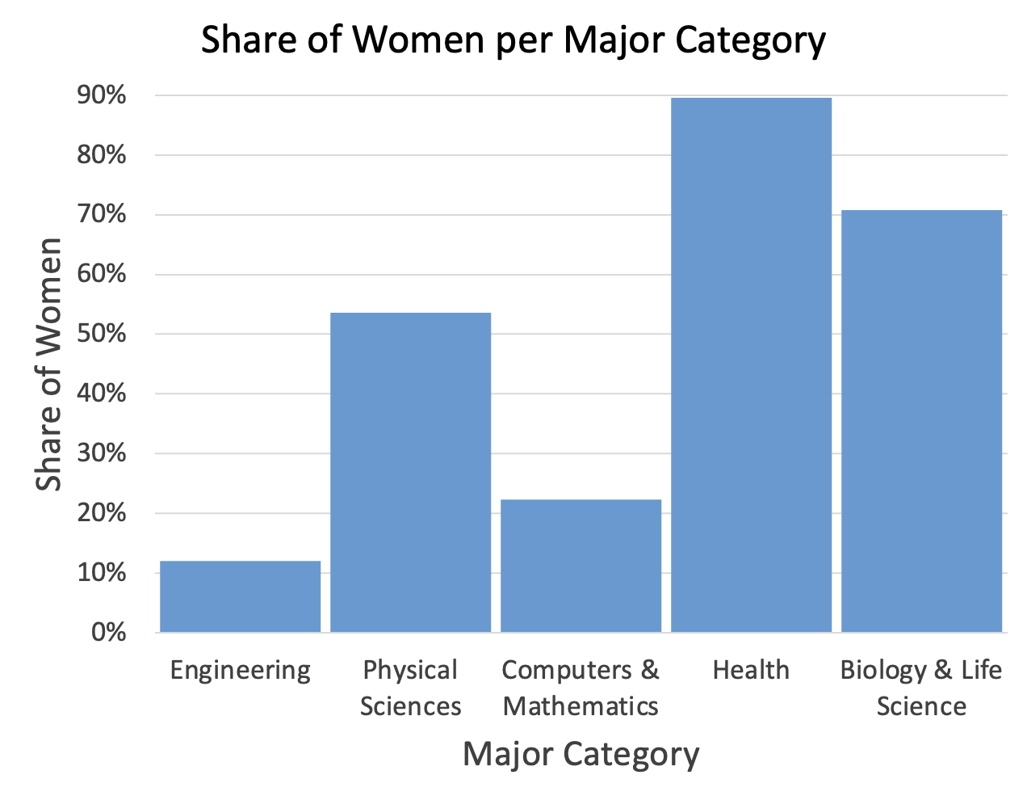
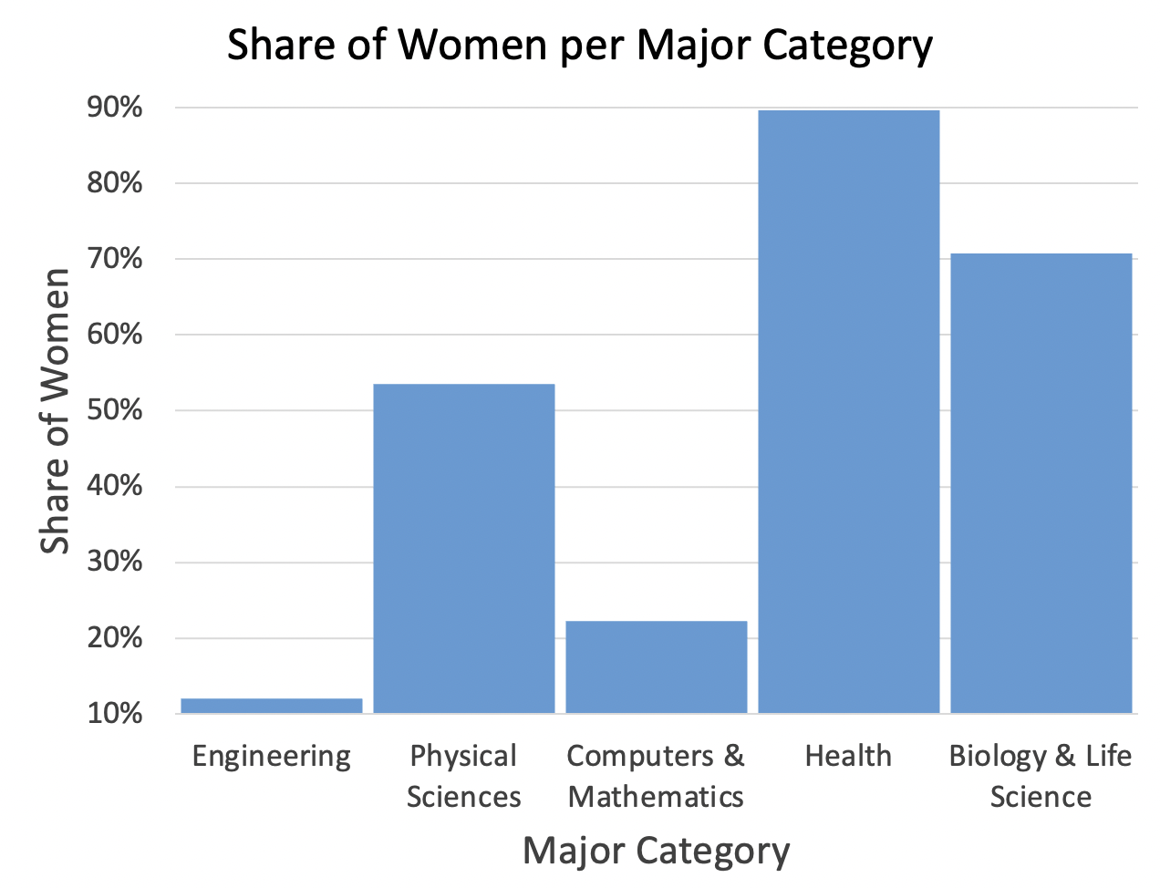
How do we avoid bias & trickery?
Design Contentiously & Read Critically
→ Axes
Data: https://github.com/fivethirtyeight/data/blob/master/college-majors/women-stem.csv
Notes:
Last but not least, another way to bias a chart is by choosing unexpected or unusual axis ranges. For example here I have the same data plotted 4 times. In each plot I use a different range of values on the y-axis.
The first is chosen to make engineering look even smaller, the second is chosen to make health look even better, and the third employs both of these tricks at once.

Slide 9
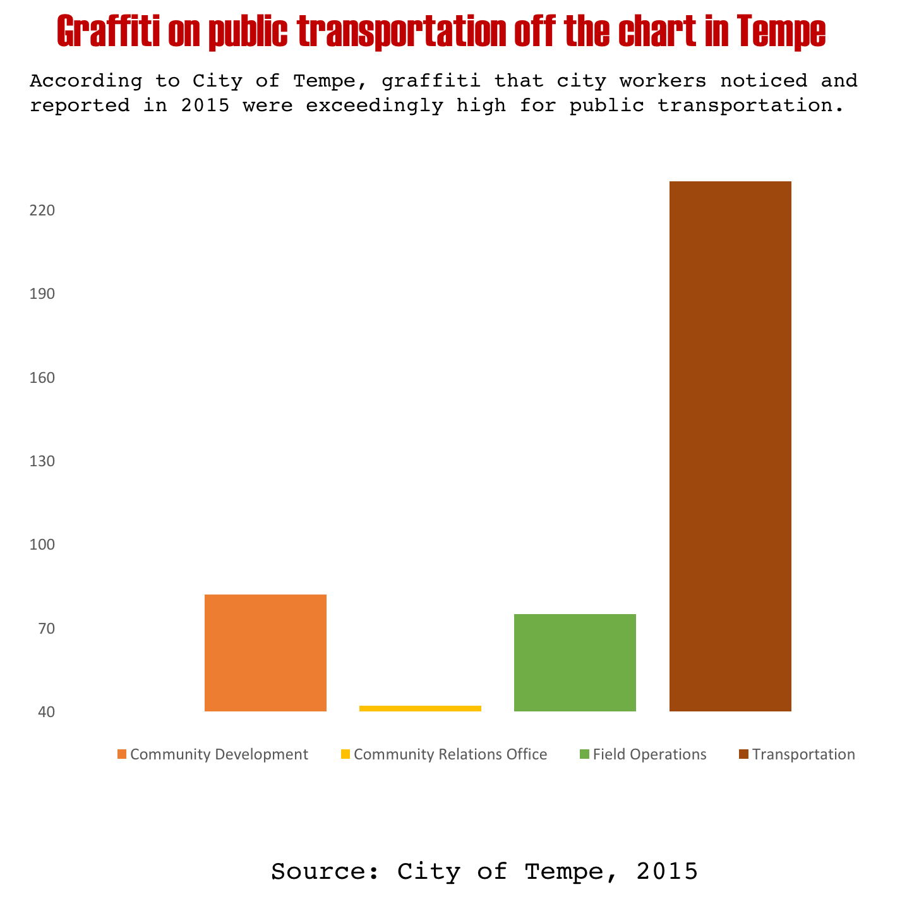
Let’s practice
Take a critical look at this chart. Notice anything?
https://www.vislies.org/2017/gallery/
Notes:
Strange categorization where one group is far larger than the others

Slide 10
Let’s practice
Take a critical look at this chart. Notice anything?
Re-design the chart (you can add more data if you want)
https://www.vislies.org/2017/gallery/
Notes:
Doesn’t start at 0,
Strange categories that don’t span a lot of area

Slide 11
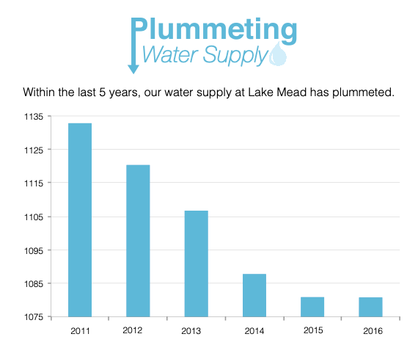
Let’s practice
Take a critical look at this chart. Notice anything?
https://www.vislies.org/2017/gallery/
Notes:
Super tiny range shown on the y-axis

Slide 12
Let’s practice
Take a critical look at this chart. Notice anything?
Re-design the chart (you can add more data if you want)
https://www.vislies.org/2017/gallery/

Slide 13
Design Rules of Thumb
No unjustified 3D / 2D

Slide 14
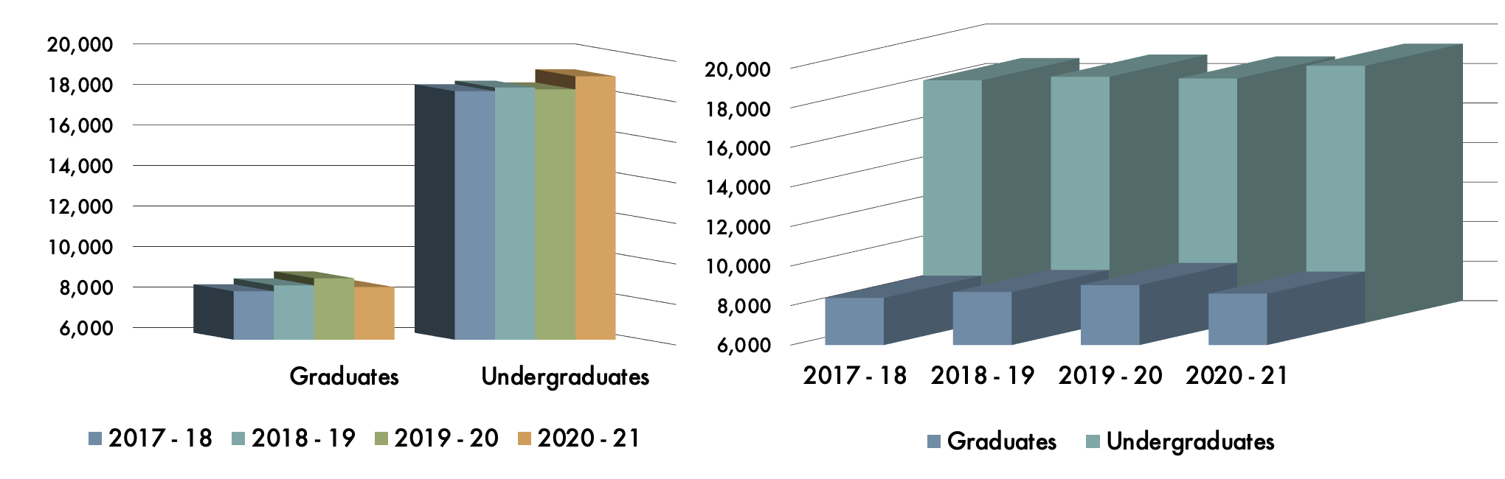
Design Rules of Thumb
No unjustified 3D
– What do we gain from using 3D here? (What does the 3rd dimension encode?)
– What do we lose from using 3D here?
Notes:
-3rd dimension doesn’t add any data to our visualization (depth of bars tells the reader nothing about the data)
-Occlusion (ex. Hard to read values for graduates in 2020-21, and undergrads in 2019-20)
-Depth distortion (which is higher 19-20 undergraduates or 18-19 undergraduates?)

Slide 15
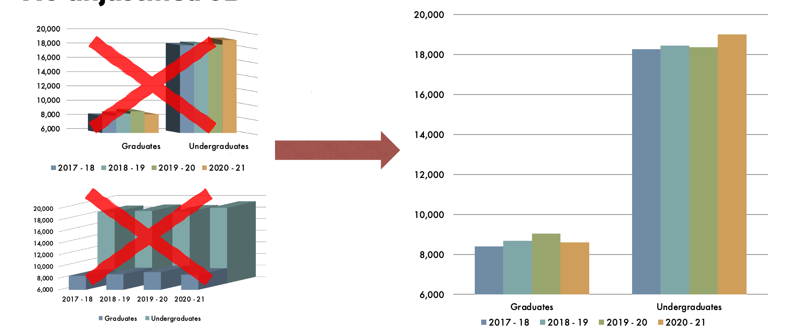
Design Rules of Thumb
No unjustified 3D
Notes:
which is higher 19-20 undergraduates or 18-19 undergraduates?

Slide 16
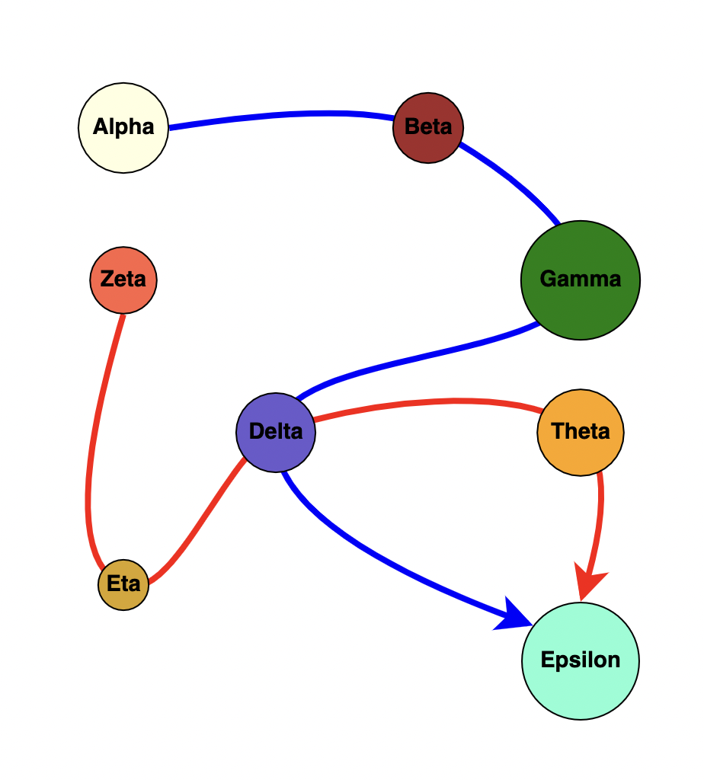
Design Rules of Thumb
No unjustified 2D
Your task: What color is Delta?
Notes:
2D – a little less adhered to than no unjustified 3D, but Tamara’s point is to think about your users’ main task. What do they need to do, and does a visualization make that task easier? This rule of thumb essentially says if the task doesn’t need a 2d visualization then don’t use one.

Slide 17
Design Rules of Thumb
No unjustified 2D
Your task: What color is Delta?
Node | Color
Alpha | White
Beta | Maroon
Delta | Purple
Epsilon | Teal
Eta | Mustard Yellow
Gamma | Green
Theta | Orange
Zeta | Pink

Slide 18
Design Rules of Thumb
No unjustified 3D / 2D
Eyes beat memory

Slide 19
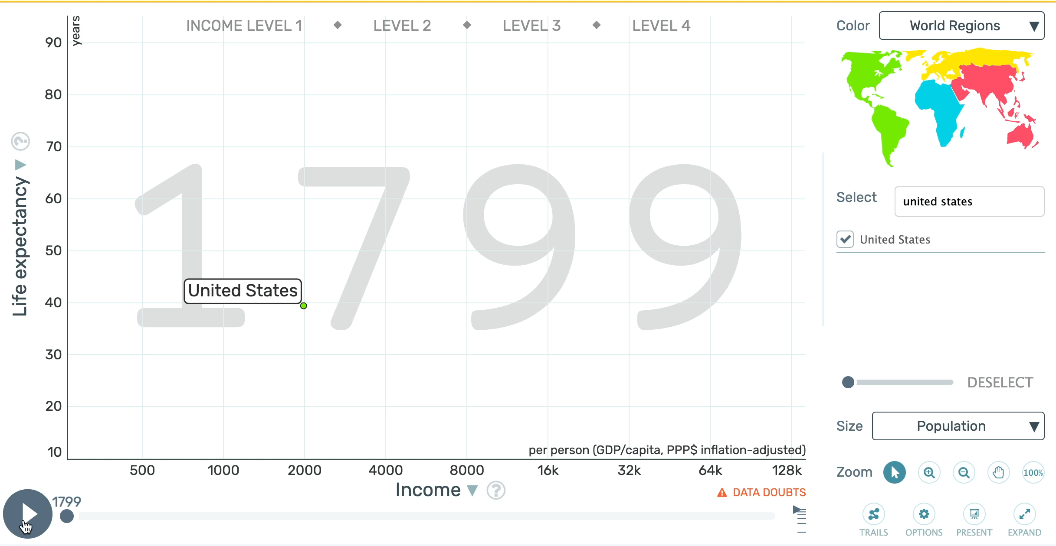
Design Rules of Thumb
Eyes beat memory
Notes:
Here’s an example, this visualization shows income, life expectancy, and population of the US over time. I’m going to let you watch the entire animation here.

Slide 20
Design Rules of Thumb
Eyes beat memory – What did the United State’s trajectory look like from1804 to 2018?
Notes:
Now, I want you to answer this question for me. Any thoughts?

Slide 21
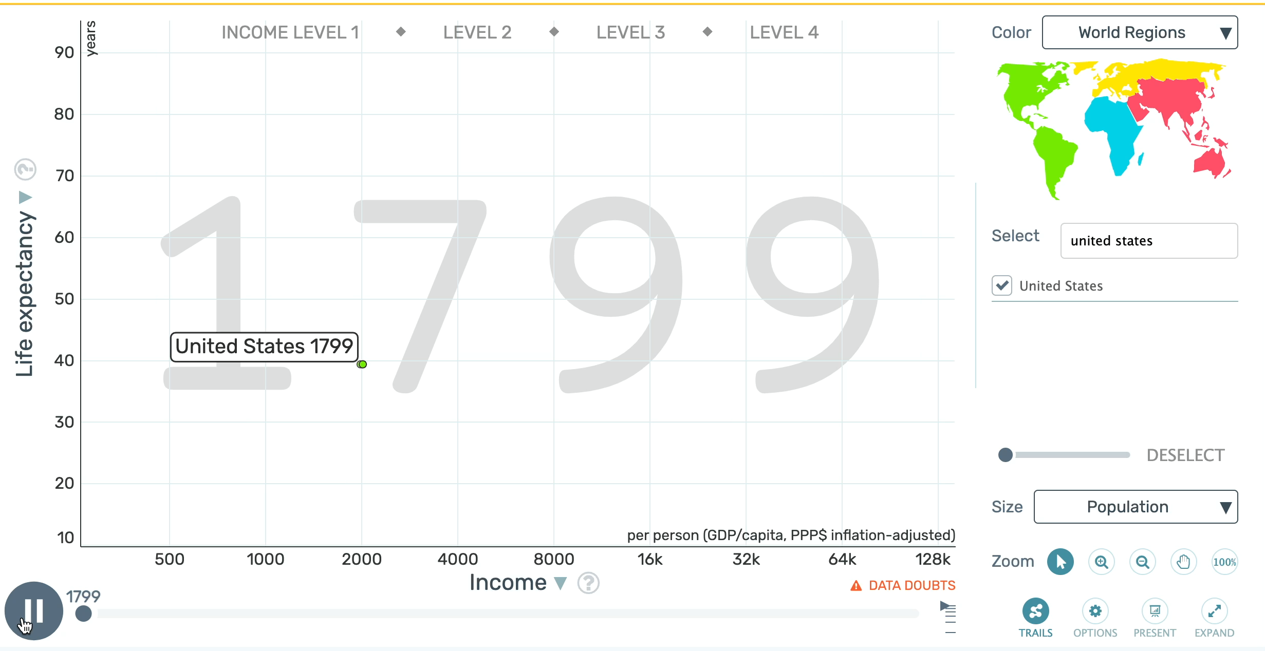
Design Rules of Thumb
Eyes beat memory – What did the United State’s trajectory look like from1804 to 2018?
Notes:
Now let’s looks at this version of the visualization, which unlike the previous, does not require you to use your memory.
You’ll notice in this case, we record the trajectory. That makes it a lot easier for you to answer my question, because you can use your eyes as opposed to your memory.

Slide 22
Design Rules of Thumb
No unjustified 3D / 2D
Eyes beat memory
Resolution over immersion
Notes:
Sometimes, a clean interface is much more effective (and realistic) than an immersive representation.

Slide 23
Design Rules of Thumb
Resolution over immersion – Immersion often comes at the cost of resolution and isn’t always feasible. A high-res display can achieve a lot.
Notes:
Here are two visualizations that show success rates of scoring from different positions on a basket ball court.
Now, each of these could have been created as an immersive display instead of as a high-resolution visualizations. However, that would require special equipment, it would also limit the user’s access to other equipment (such as their computer or a notebook), and the immersive displays would not give the same high-level overview (the user would have to move around to see different areas of the court and would have to rely on their memory to put together a high-level picture).
Of course there are some cases where immersion is useful. However, more often than not, a high-resolution display can achieve everything you need.

Slide 24
Design Rules of Thumb
No unjustified 3D / 2D
Eyes beat memory
Resolution over immersion
Overview First, Zoom and Filter, Detail on Demand

Slide 25
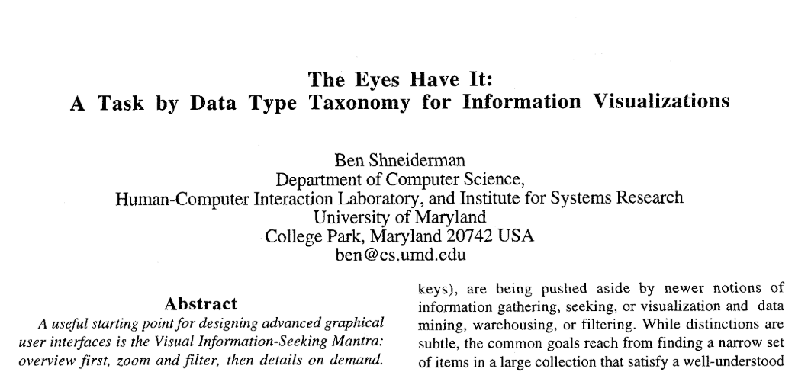
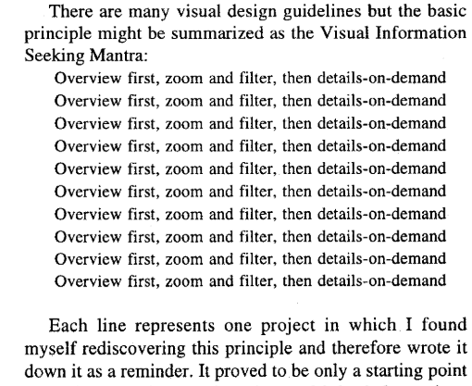
Design Rules of Thumb
Overview first, zoom and filter, details on demand – Motto that guides most visualization design
Notes:
Comes from Ben Shneiderman, who legit wrote it in a paper like this. Now, what does this look like in practice?

Slide 26
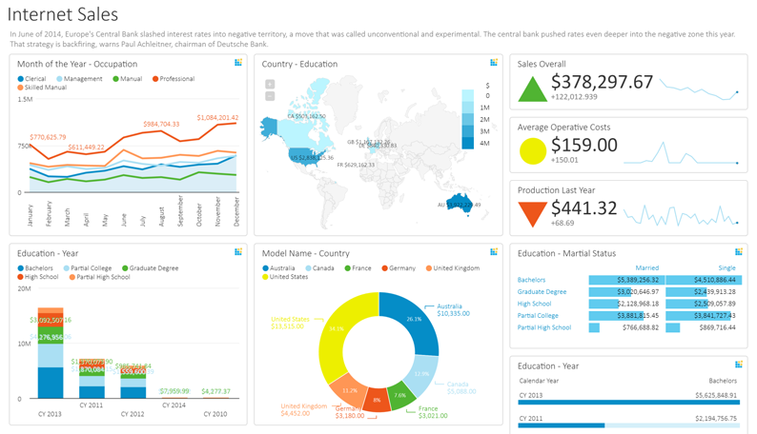
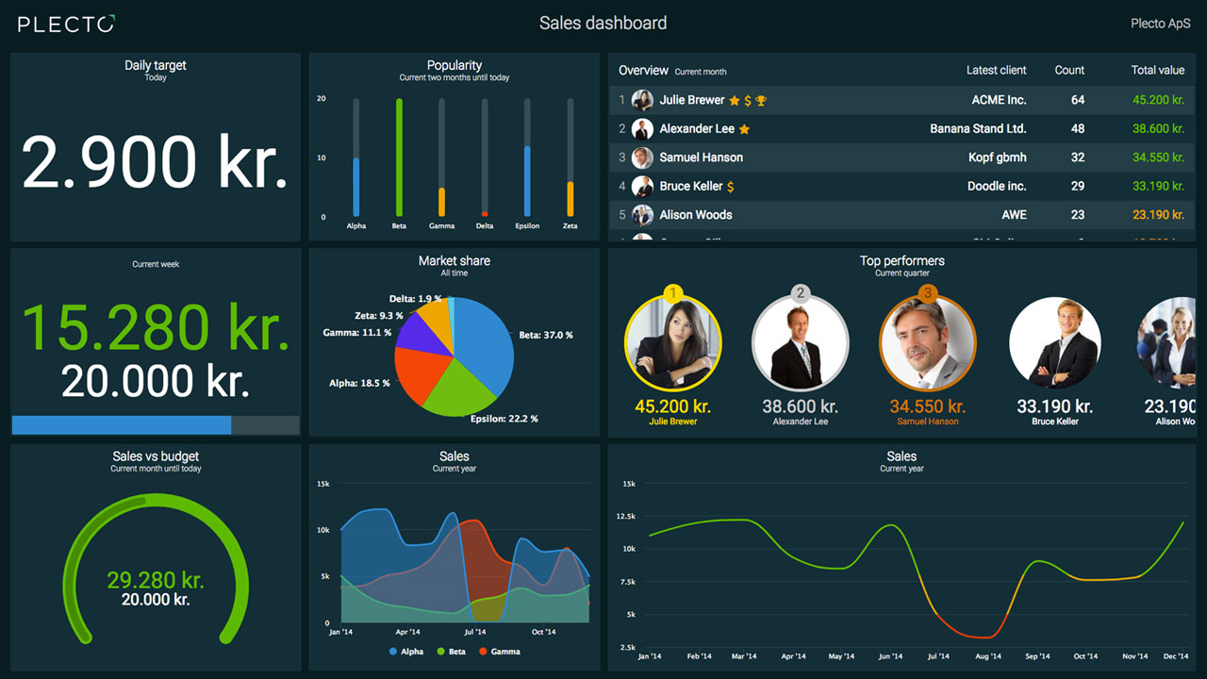
Design Rules of Thumb
Overview first, zoom and filter, details on demand – Motto that guides most visualization design
*This design guideline is most common for visual analytic tools
Notes:
When you have a lot of data, let the users see a high-level snapshot of it all at first. This helps them get a sense of the entire landscape of the data they’re looking at. However, still give users the ability to drill down into specific parts of the data. For example, let the user click on any of the boxes in either of these dashboards and zoom in to get a closer, more detailed look at a specific slice of the dataset.

Slide 27
Design Rules of Thumb
No unjustified 3D / 2D
Eyes beat memory
Resolution over immersion
Overview First, Zoom and Filter, Detail on Demand
Responsiveness is required

Slide 28




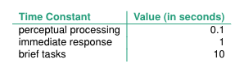
Design Rules of Thumb
Responsiveness is required – Be aware of time from click to response
Notes:
When you add interaction to a visualization, people will expect an immediate response. Therefore you need to be aware of the amount of time between a click and an update in your visualization.

Slide 29
Design Rules of Thumb
No unjustified 3D / 2D
Eyes beat memory
Resolution over immersion
Overview First, Zoom and Filter, Detail on Demand
Responsiveness is required
Get it right in black and white

Slide 30
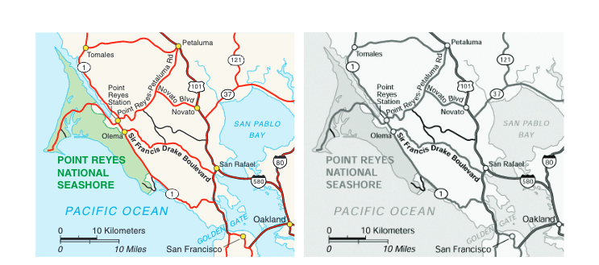
Design Rules of Thumb
Get it right in black and white – Use luminance to communicate data, and consider hue and saturation secondary
Notes:
Luminance is the lightness / darkness of a color. This rule means you should strive to design visualizations such that they are effective based only on luminance, and then worry later about adding in colors and making them aesthetically pleasing. The reasoning here is that once a visualization effectively communicates your data it’s relatively easy to play with hues and saturations to make a visualization look aesthetically appealing, however the opposite is not necessarily true. Also, people are going to look at things in black and white / grayscale. Don’t make your vis useless to people without color printers!

Slide 31
Design Rules of Thumb
No unjustified 3D / 2D
Eyes beat memory
Resolution over immersion
Overview First, Zoom and Filter, Detail on Demand
Responsiveness is required
Get it right in black and white
Function first, form next

Slide 32

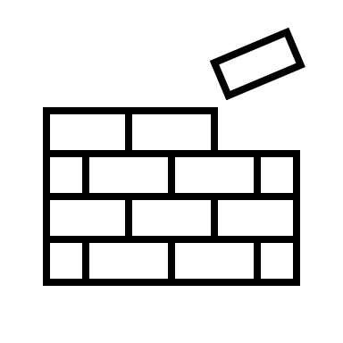




Design Rules of Thumb
Function first, form next – Aesthetics are easy fixes, functionality is not
Notes:
Ex. Changing the color scheme of a dashboard is easy. Designing and implementing an effective overview or drilldown mechanism is not

Slide 33
Practice
Find a partner to work with
Choose a dataset of interest to you
Build a visualization that shows something interesting in the data
Modify your visualization:
Make a version that follow’s Tufte’s Data-Ink Ratio guidelines
Make a version that uses “Chart Junk” to entice the reader
Make a version that is deceptive
Make a version the violates a design rule of thumb

